Slide 1

Trusts for people with disabilities…when do you need one? What Type? How do you select a trustee?
Megan Brand, Executive Director, CFPD
Nancy “Susie” Germany, Esq.

Slide 2
Agenda
When/why do you need a trust?
Types of Trusts
Things you need to ask your client about the potential beneficiary
Considerations when Selecting a Trustee

Slide 3

When do you need a trust

Slide 4
When/why you need a trust
Individual with a disability receives or plans to receive Supplemental Security Income (SSI) or a Medicaid benefit that has a $2,000 resource limit.
Individual would benefit from the protection of trust.
Individual expects to receive funds (inheritance, personal injury settlement, back payment in Social Security, liquidation of an asset) that are greater than the resource limit and cannot be spent down in the month of receipt.
Family members want to set aside funds for the benefit of the individual either now or in the future.

Slide 5
Types of Trusts: First Party
Funds belonging to the individual
Individual:
Individual Trust Document is subject to Colorado Department of Health Care Policy and Financing (HCPF) approval.
Can be settled by the individual, court, parent, grandparent or guardian of beneficiary
Payback provisions on death or termination of trust (Depends on trust document)
Only permitted for those under the age of 65
Pooled: Trust Document that is written for the individual beneficiary
Non-Profit must serve as trustee (Ex: CFPD)
Can be settled by the individual, court, parent, grandparent, or guardian of beneficiary
Master trust document—already approved by SSA and Medicaid
Allows for portability from state to state
A spending plan must be completed for individuals funding trusts age 65 and older.

Slide 6
Types of Trusts: First Party
Trust Oversight
Individual: Trust Document that is written for the individual beneficiary
  Federally: 42 USC § 1396 (d)(4)(A)
  Colorado: C.R.S. §15-14-412.8 and 10 CCR 2505-10 8.100.7.E.6.b
Pooled:
Federally: 42 USC § 1396 (d)(4)(C)
  Colorado: C.R.S. §15-14-412.9 and 10 CCR 2505-10 8.100.7.E.6.c

Slide 7
Types of Trusts: Third Party from anyone who is not the individual/beneficiary
Individual Trusts (also called Special/Supplemental Need Trust)
Drafted by an attorney as a stand-alone document or part of a Will.
No Medicaid payback provisions required.
More flexibility, especially in movement among states.
Third Party Pooled Trust
  No Medicaid payback provisions
Master trust document—already approved by SSA and Medicaid
Allows for portability from state to state

Slide 8
Types of Trusts: Third Party
Trust Oversight
Individual Trusts
  Federally: POMS SI 01120.200
  Colorado: C.R.S. §15-14-412.8 and 10 CCR 2505-10 8.100.7.E.6.d
  Individual Trust Document
Third Party Pooled Trust
  Federally: POMS SI 01120.200
  Colorado: 10 CCR 2505-10 8.100.7.E.6.d
  Master Pooled Trust Document

Slide 9
Types of Trusts: Some Examples
First Party Pooled Trust
Sam gets a back-payment in Social Security of $35,000. He is 68 years old.
First Party Individual Trust
Sophia is injured at birth and receives a $2million net settlement
Third Party Pooled Trust
Dan’s parents want to set aside some money for him each month to help him pay his bills so that he can get used to these services for when they’re no longer here. He also needs help with his Medicaid Redetermination and housing needs.
Third Party Individual Trust
Sarah’s parents are working on their will and want to leave aside funds for their daughter for when they’re gone. They expect her portion to be about $500,000.

Slide 10
Things you need to ask your client about the potential beneficiary

Slide 11
What you need to know
Person’s age and life expectancy
Are they likely to benefit from the trust?
How is the trust being funded?
How much will fund the trust?
Is the individual receiving Medicaid now or will they need to apply?
Are there other family members with a disability who could benefit from the trust fund proceeds post-death?
Does the individual have dependents such as a spouse or children?

Slide 12
What you need to know
Does the individual have a formal disability determination?
Does the individual have outstanding pre-trust debts?
Does the individual need support to assist them in the application/onboarding process?
Are any exempt assets being considered?
  House, Car, Burial Plan, etc.
Do they want to give money to others?
Do they want/need to pay for shelter or food costs?
What are their ongoing/monthly needs?

Slide 13
When the Pooled Trust is the Best Option
The set-up of the trust is time sensitive
  The Trust is already approved by Medicaid and SSI
  The disability determination process is simplified
The beneficiary may move out of state
  Transferring from one pooled trust to another can be simpler
The asset size makes sense
  The average pooled trust is $35,000
  Higher asset trusts may still make good sense in the pooled trust.
There are no family members available or none who want to take on this liability/responsibility
The set-up and management fees are typically less expensive

Slide 14
When the Pooled Trust is the Best Option
The beneficiary would have a difficult time working with a family member trustee
The beneficiary needs case management or additional resources/access to community supports that the PSNT can provide.
Many pooled trust organizations also serve as trustee of individual (first and third party) trusts in addition to the pooled trust.
Some pooled trust organizations offer ancillary services to support professional or family member trustees. (Ex: Fee for service case management to consult, serve as distribution trustee/manager)

Slide 15
Considerations when Selecting a Trustee

Slide 16

First Up… the Elephant in the Room
Not all Trustees, Not all Pooled Trusts are created equal
Sometimes there are bad actors

Slide 17
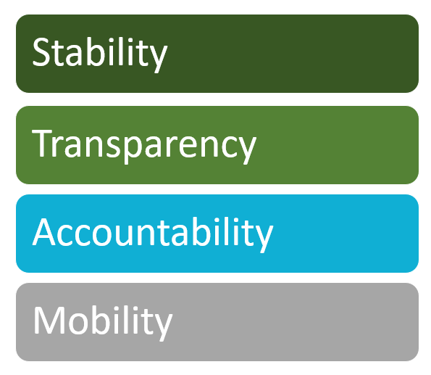
Factors to Consider

Slide 18
STABILITY
Note: From this point forward,
Trustee will = Pooled Trust Organization,
Bank, Trust Company, Fiduciary, etc.
Is the structure of the trustee stable?
Are the investments prudent?
  Risk tolerance
  Who is in charge of the investments and what is the cost?
Are the fees being charged practical?
  Charging too little may be worse than charging too much.
  How much is the trustee dependent upon volunteers?

Slide 19
STABILITY
  Length of time the trust and/or affiliated organization has been in operation?
  How many people are served by the trustee?
  What are the assets under management?
  How many trusts for people with disabilities are being administered?
  Is the trustee engaging in an annual audit?

Slide 20
Transparency
What are the fees?
  Administrative
  Investment
  Are they charged monthly, quarterly, annually?
  Fees for additional services such as set-up, case management?
  Minimum and Maximum fees?
  Tax Preparation fee?
  Extra Charges?

Slide 21
Transparency
How is policy created?
  Board committee
  Trust Committee
  Individual to the trust office/administrator
How are requests made by the beneficiary?
  Are they accessible for my beneficiary?
  (Ex: in writing only? Or via Phone, Text, E-mail, Mail, Fax, in person?)

Slide 22
Transparency
What is the Approval Process?
  Staff involvement or approval authority.
  Board/Committee involvement.
  Is there an Appeal process?
How long does it take to process a distribution request?
  May be dependent on approval needed and type of distribution (Ex: Vehicle takes longer than a monthly cable bill)

Slide 23
Transparency
    Logistics of Distributions
How “creative” is the trustee in their distributions?
Do they make purchases in person?
Do staff have access to a credit card or do they rely only on checks?
Do they allow reimbursements to others?
Are they utilizing TrueLink cards or other pre-paid debit cards for distributions?

Slide 24
Accountability
Is the trust accountable to someone?
Board or Committee Oversight?
Clear chain of command within staff?
Does some third party have the power to ask questions?
Statements:
How often are they sent?
What is the process for asking questions about the statements?
Are they clear and easy to understand?
Is the trustee adhering to Fiduciary Duties?

Slide 25
Accountability
  What is the Mission/vision of the organization?
  What is the Board structure?
    Do I know or recognize the board members?
    What is the board involvement in requests?
    Are they providing general oversight, oversight for specific requests?
    Or are they reviewing every request?
  For Pooled Trusts specifically, are they aligned with the Guidelines for PSNTs* which were developed in 2016 (and revised in 2019 by the National Pooled Trust Standards Committee and then adopted by the Alliance of Pooled Trusts?

Slide 26
Accountability
  Are the trustees attending, presenting or members of some of the following organizations?
  CO Elder Law Retreat or other CLEs
  Alliance of Pooled Trusts
  National PLAN Alliance
  NAELA
  CELA
  Stetson University SNT Conference
  Special Needs Alliance

Slide 27
Mobility
The beneficiary may move out of state
The trust beneficiary should consider the portability of the trust when they are considering the type of trust.
An individual, first party trust would need to be approved in each state the beneficiary resides and the trust termination provisions and state payback at the time of the beneficiary’s death can be the biggest obstacle to approval of the trust agreement in the new state.
Conversely, a first party pooled trust can port from one PSNT to another and this is codified in the POMS at SI01120.199.F.2

Slide 28
All the things! Ask questions, hot topics, concerns

Slide 29
Thank You
Megan Brand
Executive Director
CFPD - Colorado Fund for People with Disabilities
Direct: 303-476-6315 Main: 303-733-2867
www.cfpdtrust.org
mbrand@cfpdtrust.org
Susie Germany
Germany Law Firm, P.C.
Attorney and Counselor at Law
Phone 303-454-3711
Susie@coelderlaw.net
www.coelderlaw.com

